Slide 1

FIGLUT CUSTOMER LOYALTY AND RETENTION SYSTEM

Slide 2
BENEFITS
Identify and communicate with existing customers
Easy to use platform
Create your own unique shortcode
Cost effective
Excellent return on investment

Slide 3
HOW IT WORKS
Sign up via www.figlut.com
Create in store poster with shortcode
Customers SMS the shortcode to a unique number
Create a promotion or question
Log into your account on Figlut and purchase credits
Customers receive a welcome SMS and unsubscribe details
Select customers to send SMS to and send the message out
Check in your account for customer replies
Notice and increase in customer loyalty and retention

Slide 4
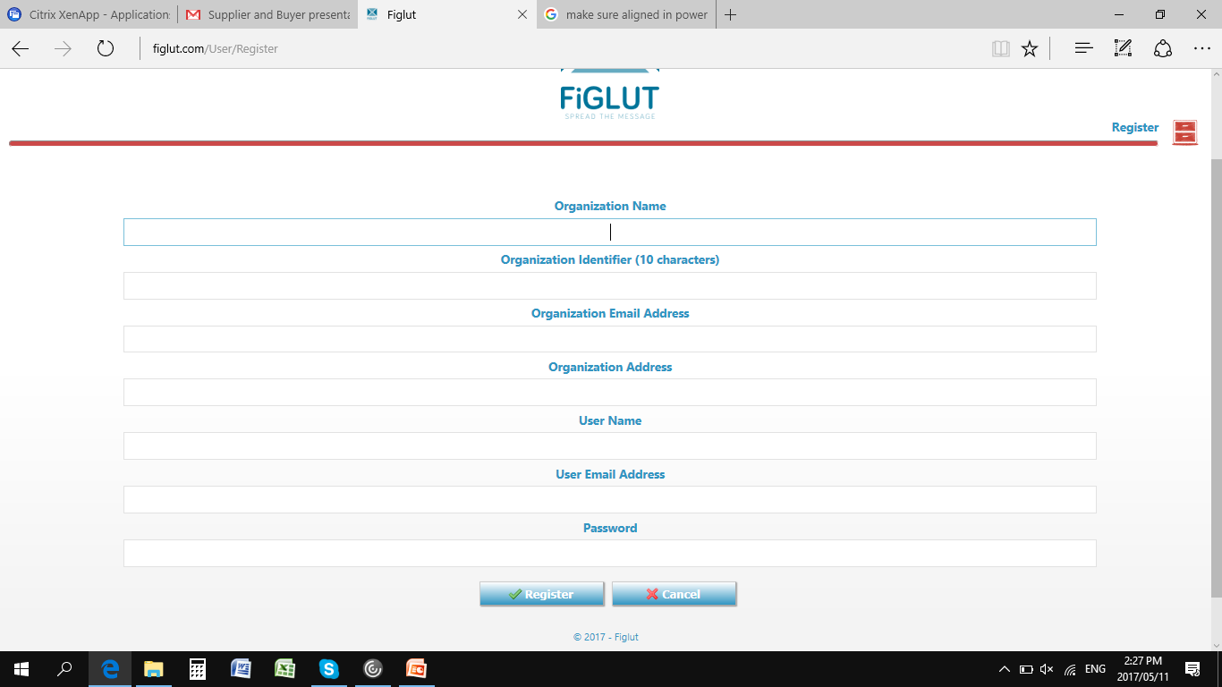
EASY REGISTRATION

Slide 5
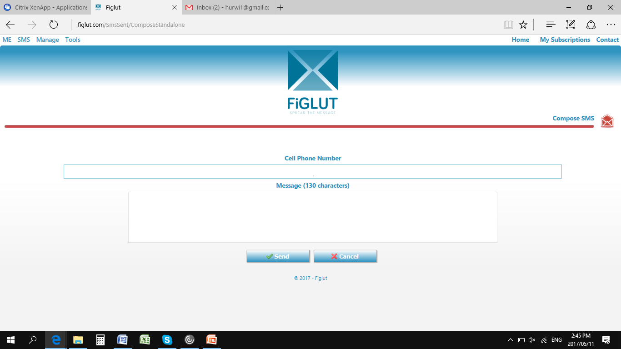
EASY MESSAGING
T
T

Slide 6
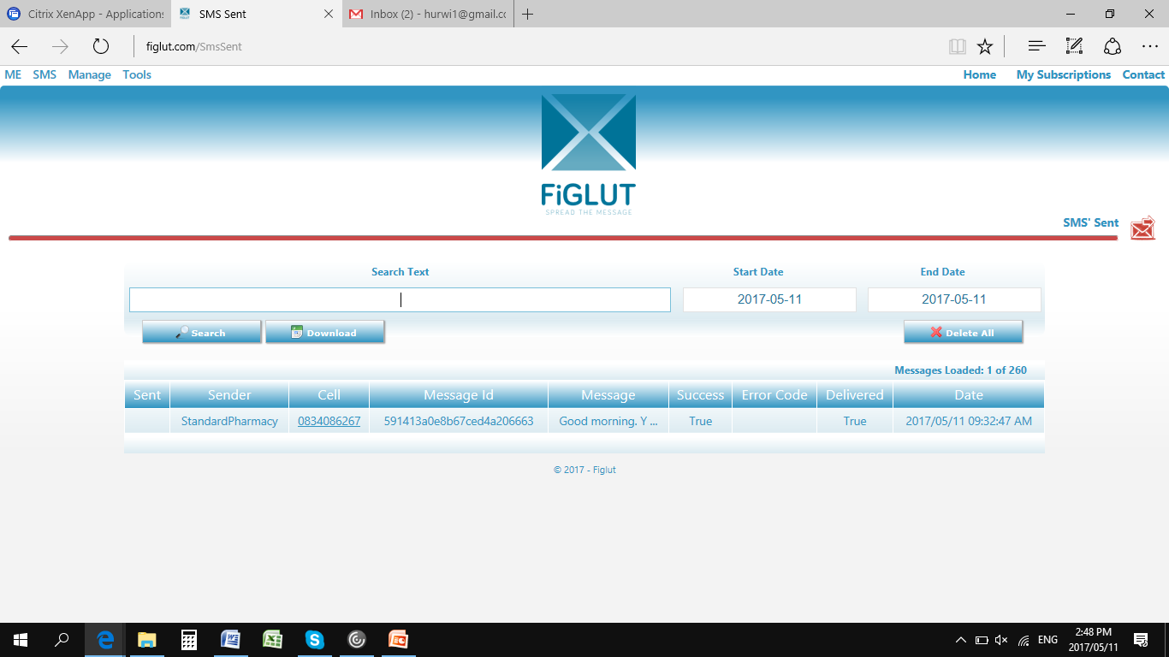
MESSAGING HISTORY AND REPLIES
T
T
T
T

Slide 7
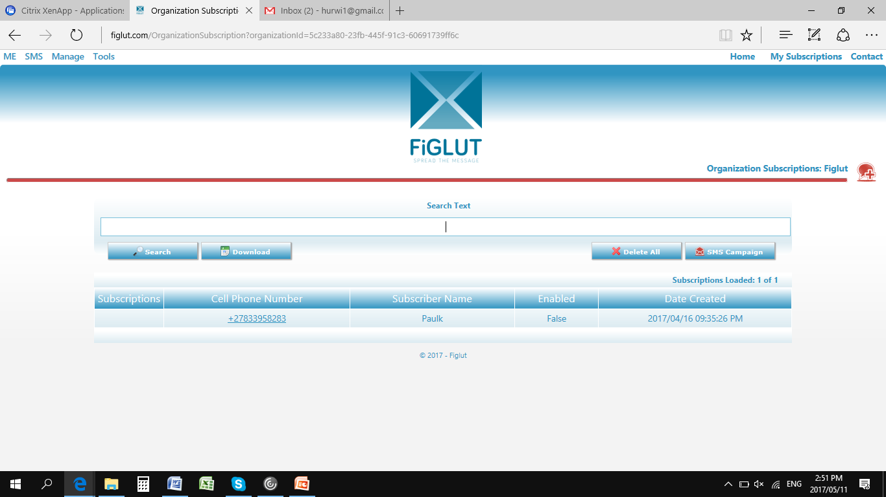
CUSTOMER DATABASE
T
T
T
T

Slide 8
CONTACT
T
GREG
0798754747
greg.hurwitz@figlut.com
PAUL
0833958283
paulkolo@figlut.com
T
T

